Slide 1
Python Intro for ML
By Dr. Ali Saeed

Slide 2
Introduction to Python
Definition
Variables / Arrays/ List / Set / Tuple
Dictionary
Condition
Loops
Classes
Functions
Popular Libraries

Slide 3
Definition
Python is a high-level general-purpose programming language. Its design philosophy emphasizes code readability with the use of significant indentation. Its language constructs and object-oriented approach aim to help programmers write clear, logical code for small- and large-scale projects

Slide 4
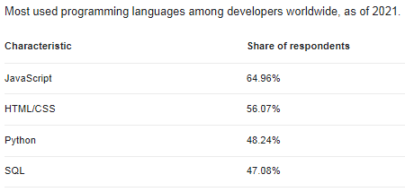
Python users statistics

Slide 5
Variables declaration and List
x=20
y=3.4
z="test match"
w=["car",2,4.6]
print(x)
print(y)
print(x)
print(w)
print(w[0])
print(w[1])
print(w[2])
Note: Python does not have built-in support for Arrays, but Python Lists can be used instead.

Slide 6
List functions in Python
Change an Item from List
w[0]="bus"
print(w)
Append item at the last
w.append(“Cycle")
Print(w)
Remove an item from the list by index
w.pop(0)
print(w)
Change an Item from List
w[0]=1
print(w)
Remove an item by name
w.remove(‘bus’)
print(w)
Change an Item from List
r=len(w)
print(r) OR
print(len(w))
Note: The list's remove() method only
removes the first occurrence of the specified value.

Slide 7
Show all elements of List
Here is a loop to show all elements of list:
// List traversal
for x in range(len(new_list)):
print (new_list[x])
Or
print(new_list) // print complete list
Python range() Function
The range() function returns a sequence of numbers, starting from 0 by default, and increments by 1 (by default), and stops before a specified number.

Slide 8
Show all Elements of List
for x in new_list:
print (x)
Here x represent a single data item of the list.

Slide 9
Dictionary
Dictionaries are used to store data values in key:value pairs.
Duplicates keys Not Allowed (example on next slide)
As of Python version 3.7, dictionaries are ordered.
In Python 3.6 and earlier, dictionaries are unordered.
dic={
"st1":"Ali",
"st2":"Usman",
"st3":“Imran",
"st4":“Khan"
}
Print complete items:
print(dic.items())
Print the “keys” of the dictionary:
print(dic.keys())
Print complete values:
print(dic.values())
Print a single element:
print(dic['st2'])

Slide 10
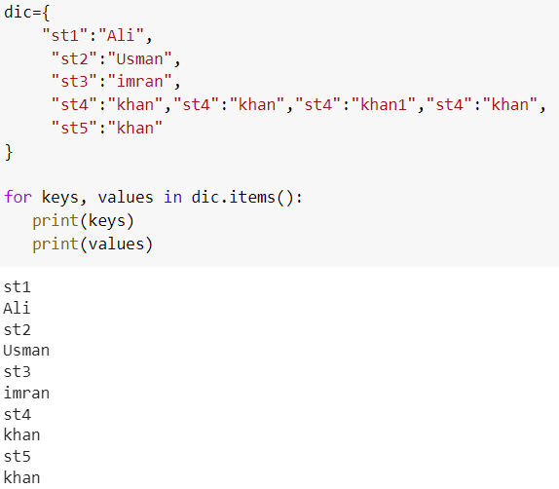
Duplicate Keys example
Input
Output

Slide 11
Dictionary Traversal
Following code can be use to traverse a dictionary in Python
for keys, values in dic.items():
print(keys)
print(values)

Slide 12
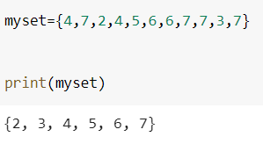
Set
Set items are unordered, unchangeable, and do not allow duplicate values.
myset = {"apple", "banana", "cherry"}
Convert a set into the list:
s = list(myset)
print(s)
Input
Output

Slide 13
Set Traversal
myset={4,7,2,4,5,6,6,7,7,3,7}
print(myset)
for val in myset:
print(val)

Slide 14
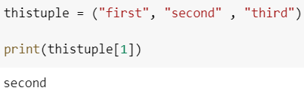
Tuple
Allow duplicate values
A tuple is a collection which is ordered and unchangeable.
Tuples are unchangeable, meaning that we cannot change,
Since tuples are indexed, they can have items with the same value
thistuple = ("apple", "banana", "cherry")
print(thistuple)
Input
Output

Slide 15
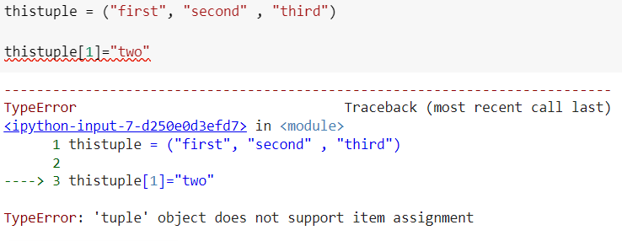
Tuple not change its contents
Tuple will produce error when we change its contents:
Input
Output

Slide 16
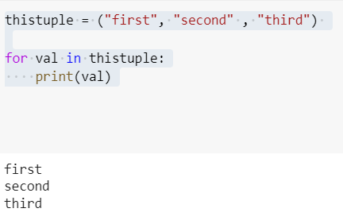
Tuple Traversal

Slide 17
Thanks

